Slide 1


CSE 470 – Class Diagram in UML
BRAC University

Slide 2
What is a Class?
Visibility
+ public
# protected
- private
~ package (default)
underline static methods
Parameters listed as name:type
method listed as name(parameters):return_type
Omit return_type when return_type is void
Abstract Class
Student
Rectangle
<<interface>>
Shape
- name: String
- id: int
- totalStudents:int
- width: int
- height: int
/ area: double
# getID():int
~ getEmail():String
# Rectangle(w:int, h:int)
+ distance(r:Rectangle):double
+ calculateArea():double
Notes:
Class
A description of a group of objects with common properties (attributes), common behavior (operations), common relationships to other objects, and common semantics
Each object is an instance of some class, and objects cannot be instances of more than one class
All objects of a given class are identical in structure (attributes) and behavior (methods) but contain different data in their attributes
A good class captures one and only one abstraction – it should have one major theme
Should be named using the vocabulary of the domain application
Name: singular noun that best characterizes the abstraction
An object or a class? Subjective; may work on an object and then begin to realize that it really needs to be a class (so you can create multiple objects)

Slide 3
What is a Class?
A general template that we use to create specific instances or objects in the application domain
Represents a kind of person, place, or thing about which the system will need to capture and store information
Abstractions that specify the attributes and behaviors of a set of objects
Notes:
Class
A description of a group of objects with common properties (attributes), common behavior (operations), common relationships to other objects, and common semantics
Each object is an instance of some class, and objects cannot be instances of more than one class
All objects of a given class are identical in structure (attributes) and behavior (methods) but contain different data in their attributes
A good class captures one and only one abstraction – it should have one major theme
Should be named using the vocabulary of the domain application
Name: singular noun that best characterizes the abstraction
An object or a class? Subjective; may work on an object and then begin to realize that it really needs to be a class (so you can create multiple objects)

Slide 4
What is an Object?
Entities that encapsulate state and behavior
Each object has an identity
It can be referred individually
It is distinguishable from other objects
Notes:
An object or a class? Subjective; may work on an object and then begin to realize that it really needs to be a class (so you can create multiple objects)

Slide 5
Types of Classes
Ones found during analysis:
people, places, events, and things about which the system will capture information
ones found in application domain
Ones found during design
specific objects like windows and forms that are used to build the system
Notes:
Class diagram
Name typed in top compartment

Slide 6
Potential Classes
External entities (e.g., other systems, devices, people) that produce or consume information to be used by a computer-based system.
Things (e.g., reports, displays, letters, signals) that are part of the information domain for the problem.
Occurrences or events (e.g., a property transfer or the completion of a series of robot movements) that occur within the context of system operation.
Roles (e.g., manager, engineer, salesperson) played by people who interact with the system.
Organizational units (e.g., division, group, team) that are relevant to an application.
Places (e.g., manufacturing floor or loading dock) that establish the context of the problem and the overall function of the system.
Structures (e.g., sensors, four-wheeled vehicles, or computers) that define a class of objects or related classes of objects.

Slide 7
2 Kinds of Classes during Analysis
Concrete
Class from application domain
Example: Customer class and Employee class
Abstract
Useful abstractions
Example: Person class
Notes:
Concrete
Used to create objects
Abstract
Person class is really a generalization from Customer class and Employee class
Attributes and methods common to both Customer class and Employee class
Examples of common attributes: name, address, birthdate, phone number, email address
Generally do not create objects from Person class but rather create and use employee and customer objects
Later in the design and implementation phases, we will also identify other classes such as user interface classes, data structure classes, document classes, file structure classes, operating environment classes, and various types of multimedia classes.

Slide 8
Classes
A class is a description of a set of
objects that share the same attributes,
operations, relationships, and semantics.
Graphically, a class is rendered as a
rectangle, usually including its name,
attributes, and operations in separate,
designated compartments.
ClassName
attributes
operations

Slide 9
Class Names
ClassName
The name of the class is the only required tag in the graphical representation of a class. It always appears in the top-most compartment.
attributes
operations

Slide 10
Attributes in a Class
Properties of the class about which we want to capture information
Represents a piece of information that is relevant to the description of the class within the application domain
Notes:
Attributes in a Class
Contains information that the analyst or user feels that the system should store
Represents properties that describe the state of the object
Only attributes important to the task should be included in the class
For example, for employee, employee name is a good attribute; employee hair color is not (not relevant in the business application)
Primitive or atomic types
Such as integer, string, double, date, time, boolean, …
Generally complex or compound attributes are really placeholders for relationships between classes

Slide 11
Attributes in a Class
Only add attributes that are primitive or atomic types
Derived attribute
attributes that are calculated or derived from other attributes
denoted by placing slash (/) before name
Notes:
Attributes in a class diagram
Typed in middle compartment
Derived attributes
Examples: age (subtracting birthdate from current date), GPA (calculated from grades and credit hours)

Slide 12
Class Attributes
Person
An attribute is a named property of a
class that describes the object being modeled.
In the class diagram, attributes appear in
the second compartment just below the
name-compartment.
name : String
address : Address
birthdate : Date
ssn : Id

Slide 13
Class Attributes (Cont’d)
Attributes are usually listed in the form:
attributeName : Type
A derived attribute is one that can be
computed from other attributes, but
doesn’t actually exist. For example,
a Person’s age can be computed from
his birth date. A derived attribute is
designated by a preceding ‘/’ as in:
/ age : Date
Person
name : String
address : Address
birthdate : Date
/ age : Date
ssn : Id

Slide 14
Operations in a Class
Represents the actions or functions that a class can perform
Describes the actions to which the instances of the class will be capable of responding
Can be classified as a constructor, query, or update operation
Notes:
Operations in a Class
Represents the actions or functions that a class can perform
In later phases, the operations are converted to methods (functions in C++)
Only problem domain-specific operations that are relevant to the problem should be considered
Classes normally are required to provide the means to create instances, delete instances, access individual attribute values, set individual attribute values, and other basic types of operations
At this point in development, don’t clutter up the definition of the class with these basic types of operations
Focus only on relevant problem domain-specific operations
1)Constructor operation
Creates a new instance of a class
Since creation is normally available to all classes, typically will not see constructor methods at this point in the development of the class diagram
2)Query operation
Makes information about the state of an object available to other objects but will not alter the object in any way
3)Update operation
Changes the value of some or all of the object’s attributes which may result in a change in the object’s state

Slide 15
Class Operations
Person
name : String
address : Address
birthdate : Date
ssn : Id
eat ()
sleep ()
work ()
play ()
Operations describe the class behavior
and appear in the third compartment.

Slide 16
Class Operations (Cont’d)
PhoneBook
newEntry (n : Name, a : Address, p : PhoneNumber, d : Description)
getPhone ( n : Name, a : Address) : PhoneNumber
You can specify an operation by stating its signature: listing the name, type, and default value of all parameters, and, in the case of functions, a return type.

Slide 17
Depicting Classes
When drawing a class, you need not show attributes and operation in every diagram.
Person
Person
Person
name : String
birthdate : Date
ssn : Id
Person
name
address
birthdate
eat()
sleep()
work()
play()
Person
eat ()
play ()

Slide 18
UML Representation of Class
Class Name
Attributes of Class
Operations/methods of Class
Notes:
Class representation
Compartmentalized rectangles
Top compartment: name of class
Middle compartment: structure of the class (attributes)
Bottom compartment: behavior of the class (operations)

Slide 19
Visibility of Attributes and Operations
Relates to the level of information hiding to be enforced
Notes:
Visibility in a class diagram
Shown on attributes and methods
Public
One that is not hidden from any other object
Default visibility for an method
2) Protected
One that is hidden from all other classes except its immediate subclasses
3) Private
One that is hidden from all other classes
Default visibility for an attribute

Slide 20
Visibility of Attributes and Operations
Visibility
Symbol
Accessible To
Public
+
All objects within your system.
Protected
#
Instances of the implementing class and its subclasses.
Private
-
Instances of the implementing class.
Notes:
Operations in a Class
Also can be shown on attributes
Put in front of the name of the attribute or operation on the class diagram
Visibility of the attribute/operation in the system
Public – not hidden from any object
Protected – hidden from all other classes except its immediate subclasses
Private – default; hidden from all other classes

Slide 21
Visibility (Cont’d)
Person
+ name : String
# address : Address
# birthdate : Date
/ age : Date
- ssn : Id
Attributes can be:
+ public
# protected
- private
/ derived
+ eat ()
+ sleep ()

Slide 22
Relationships among Classes
Represents a connection between multiple classes or a class and itself
2 basic categories:
association relationships
Aggregation
Composition
generalization relationships
Notes:
Relationships between Classes
One of primary purposes of a class diagram is to show the relationships that classes have with other another
All systems are made up of many classes/objects; system behavior is achieved through the collaborations of the objects of the system

Slide 23
Association Relationship
A bidirectional semantic connection between classes
Type:
name of relationship
role that classes play in the relationship
Notes:
Association Relationship
An association between classes means there is a link between the objects in the associated classes
Not a data flow (though data may flow in either direction across the association)

Slide 24
Association Relationship
Name of relationship type shown by:
drawing line between classes
labeling with the name of the relationship
indicating with a small solid triangle beside the name of the relationship the direction of the association
Provides
Patient
Medical History
Notes:
Relationships in a class diagram
Primary purpose of the class diagram is to show the relationships or associations that classes have with one another
Shown by drawing lines between classes
Triangle
Increases the readability of the diagram
Is read as “The patients provides medical history”

Slide 25
Association Relationships
If two classes in a model need to communicate with each other, there must be link between them.
An association denotes that link.
Student
Instructor

Slide 26
Association Relationships (Cont’d)
We can indicate the multiplicity of an association by adding multiplicity adornments to the line denoting the association.
The example indicates that a Student has one or more Instructors:
Student
Instructor
1..*

Slide 27
Association Relationships (Cont’d)
The example indicates that every Instructor has one or more Students:
Student
Instructor
1..*

Slide 28

Association Relationship
Role type shown by:
drawing line between classes
indicating with a plus sign before the role name
Patient
+ primary insurance carrier
Notes:
Relationships in a class diagram
Notice no triangle needed on a role

Slide 29
Aggregation Relationship
Specialized form of association in which a whole is related to its part(s)
Represented by a-part-of relationship
Specifies a whole-part relationship between an aggregate (a whole) and a constituent part, where the part can exist independently from the aggregate.
Notes:
Aggregation Relationship
You can identify these kinds of associations when you need to use words like “is a part of” or “is made up of” to describe a relationship between classes
When classes actually comprise other classes
For example, CourseOffering class is a-part-of the Course class
One way to recognize: are some operations on the whole automatically applied to its parts? For example, deleting a course will also delete all of its course offerings
One way to recognize: is there an intrinsic asymmetry to the relationship where one class is subordinate to the other?
UML notation for an aggregation relationship is an association with a diamond next to the class denoting the aggregate
Aggregations are denoted by a hollow-diamond adornment

Slide 30
Aggregation Relationship
Aggregations are denoted by a hollow-diamond adornment on the association.
Car
Engine
Transmission
Notes:
Relationships in a class diagram
Engine and Transmission are “part of” the Car; it can exist without the patient

Slide 31
Composition Relationship
A composition indicates a strong ownership and coincident lifetime of parts by the whole (i.e., they live and die as a whole). Compositions are denoted by a filled-diamond adornment on the association
Window
Scrollbar
Titlebar
Menu
Notes:
Without the Window rest of them has no existence

Slide 32
Generalization Relationship
Enables the analyst to create classes that inherit attributes and operations of other classes
Represented by a-kind-of relationship
Shows ‘inheritance’
Notes:
Generalization Relationship
The analyst creates a superclass that contains the basic attributes and operations that will be used in several subclasses.
Subclasses inherit the attributes and operations of their superclass and can also contain attributes and operations that are unique just to them
For example, a customer class and an employee class can be generalized into a person class by extracting the attributes and operations they have in common and placing them into a new superclass, Person
Subclasses (with no children) must be concrete classes
Superclasses may be abstract or concrete
Encourages analyst to focus on the properties that make each class unique by allowing the similarities to be factored into superclasses
Advantage: reduces redundancy in the class definitions
Is represented with the a-kind-of relationship
Employee is a-kind-of person
Specialization relationship
Flip side of generalization relationship
For example, an employee class can be specialized into a manager class and an engineer class

Slide 33
Generalization relationships
Hierarchies drawn top-down
Arrows point upward to parent
Line/arrow styles indicate if parent is a(n):
class: solid line, black arrow
interface: dashed line, white arrow
abstract class: solid line, white arrow
<<interface>>
Shape
+ calculateArea():double
RectangularShape
- width:int
- height: int
/ area: double
+ calculateArea():double
+ contains(x:int,y:int):bool
Rectangle
+ Rectangle(x:int,y:int)
+ distance(r:Rectangle):double

Slide 34
Generalization Relationships
Person
A generalization connects a subclass
to its superclass. It denotes an
inheritance of attributes and behavior
from the superclass to the subclass and
indicates a specialization in the subclass
of the more general superclass.
Student

Slide 35
Generalization Relationships (Cont’d)
UML permits a class to inherit from multiple superclasses, although some programming languages (e.g., Java) do not permit multiple inheritance.
Student
Employee
TeachingAssistant

Slide 36
Generalization Relationship
Person
Employee
Customer
Manager
Engineer
Notes:
UML notation is the arrowhead line with the arrowhead being toward the superclass
Generalization relationships form generalization hierarchies between classes
Inheritance
A relationship between classes where one class is the parent class of another
The child class inherits all of the parent’s attributes and operations
Supports idea of reusable code
New data types can be defined as extensions of previously defined types (rather than having to be defined from scratch)
Example: student and undergraduate student, graduate student
Traversal of hierarchy
Traversal goes up the hierarchy to find a match
Executes the first match that it finds
For example, if the attribute name was used in the Engineer class but was not defined in that class, the object will traverse its hierarchy until it finds the matching attribute; same for an operation

Slide 37
Generalization Relationship
Employee
hireDate
receivePay
performWork
Manager
Engineer
department
bonus
certifications
hireEmployee
promoteEmployee
analyze
design
Notes:
Point out:
Attributes and operations/behavior of each class
Superclass
Employee class
Generalization that contains attributes and operations common to all subclasses
Subclass
Manger and Engineer classes
Specializations of a superclass
hireDate, receivePay and performWork are also part of Manager and Engineer
In addition to having hireDate, receivePay and performWork the class Manager also has department, bonus, hireEmployee, promoteEmployee
In addition to having hireDate, receivePay and performWork the class Engineer also has certifications, analyze, and design

Slide 38
Multiplicity
Documents how many instances of a class can be associated with one instance of another class
1
provides
0..1
Patient
Medical History
Notes:
Relationships in a class diagram
Example is read “Exactly one patient provides zero or one medical histories”
Used because you may want to restrict the number of instances a class may have

Slide 39
Multiplicity
Denotes the minimum number.. maximum number of instances
Exactly one 1
Zero or more 0..* or 0..m
One or more 1..* or 1..m
Zero or one 0..1
Specified range 2..4
Multiple, disjoint ranges 1..3, 5
Notes:
Relationships in a class diagram
Used because you may want to restrict the number of instances a class may have
Zero/one or more use m or some other variable name when there is a specific number in the problem
Specified range 2 to 4 instances
Multiple, disjoint ranges 1..3, 5 == 1 to 3 or 5 instances

Slide 40
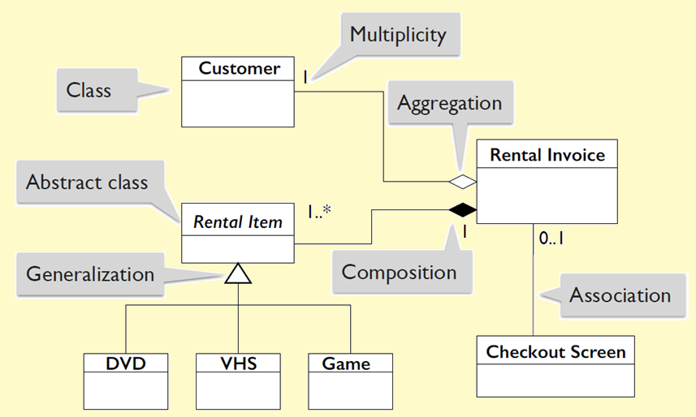
Example: Video rental store

Slide 41
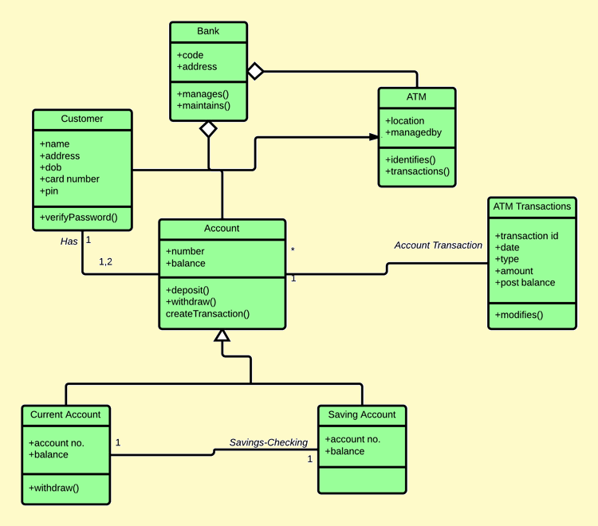

Slide 42
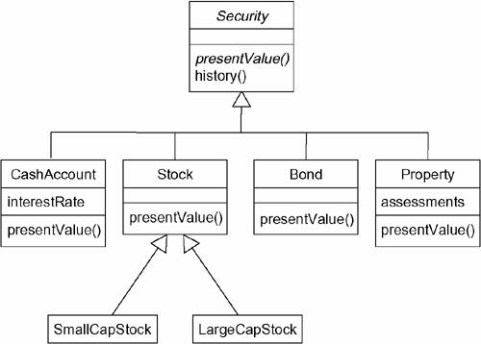
More Example of Inheritance

Slide 43
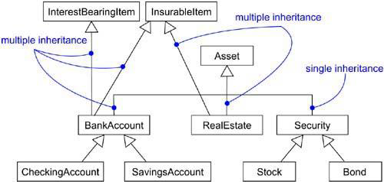
Multiple Inheritance

Slide 44
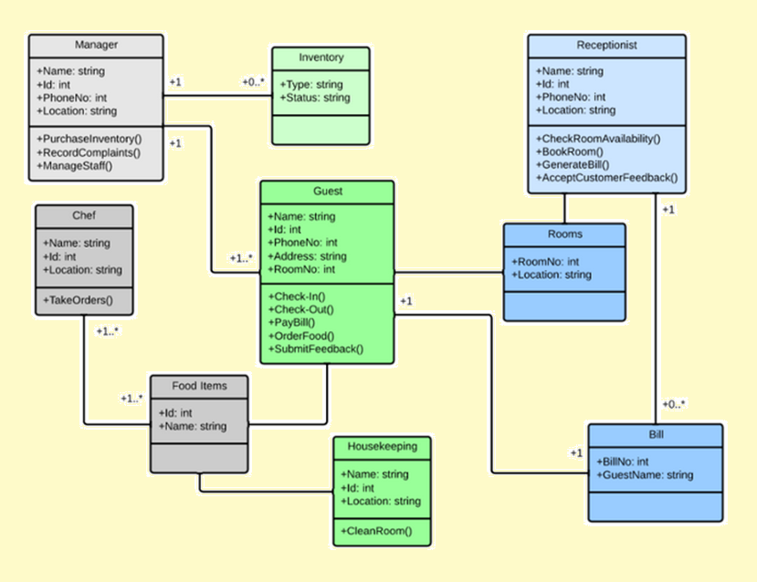

Slide 45
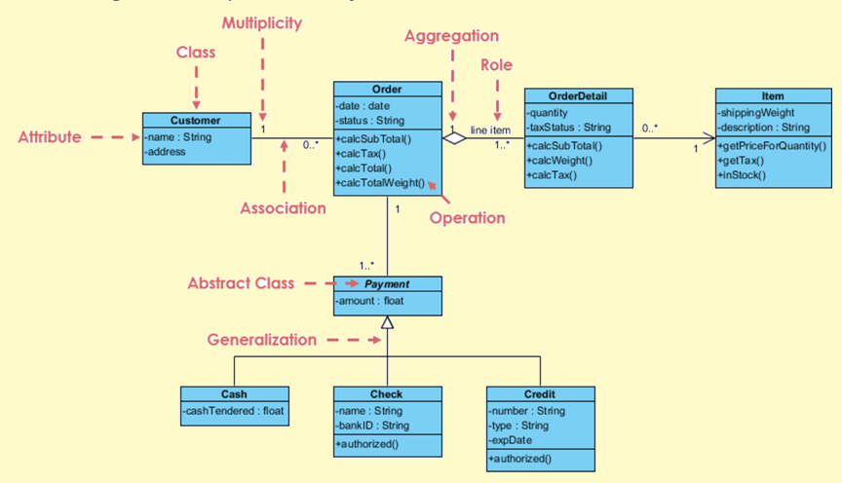

Slide 46
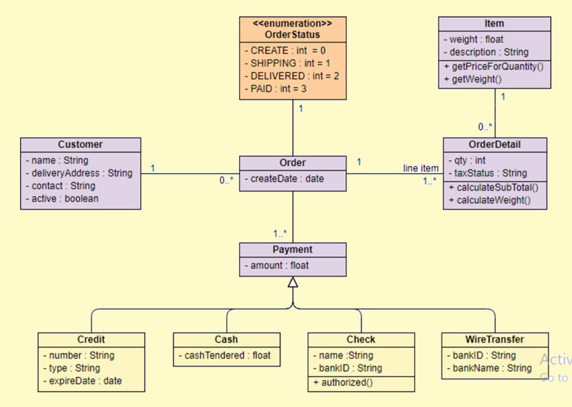

Slide 47
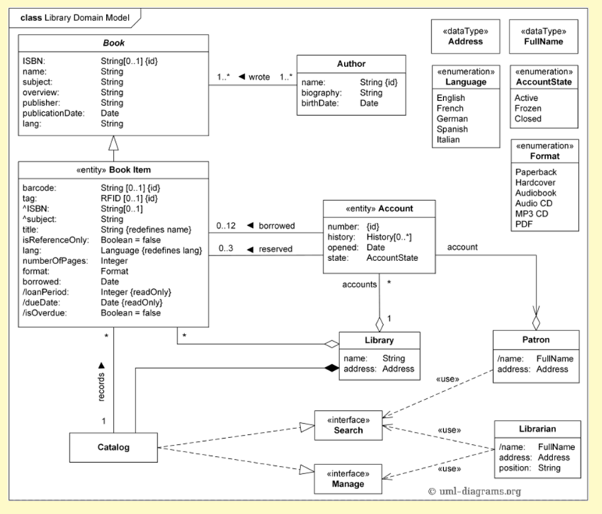

Slide 48
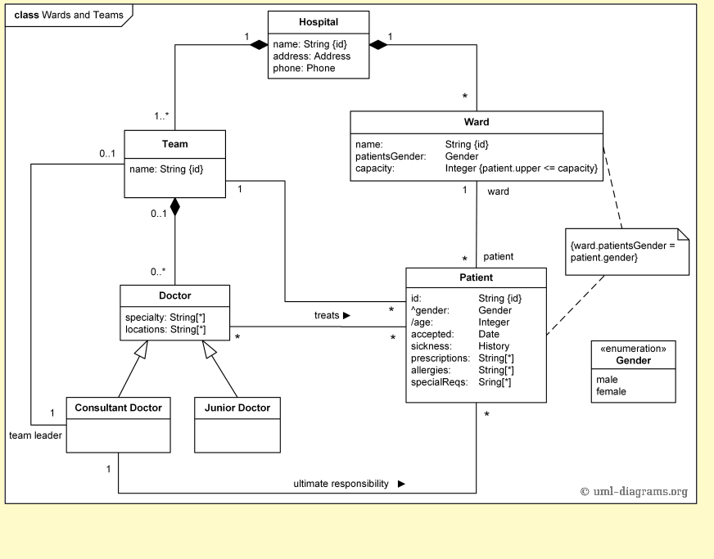

Slide 49
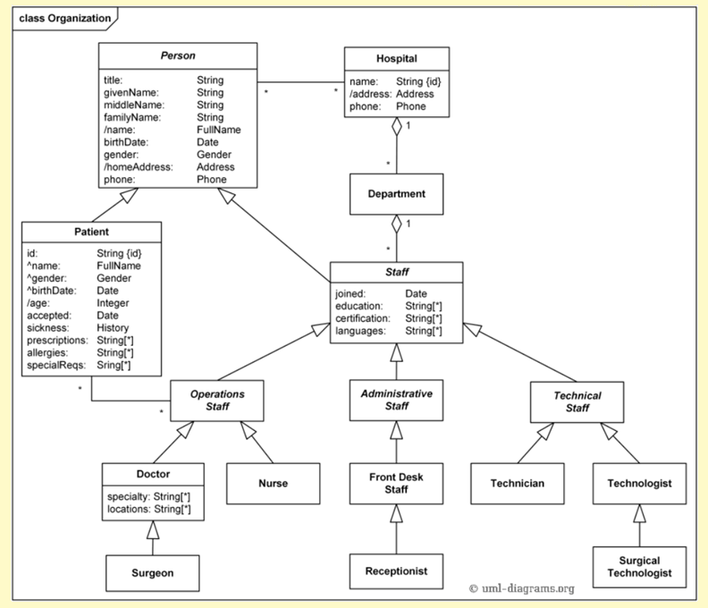

Slide 50
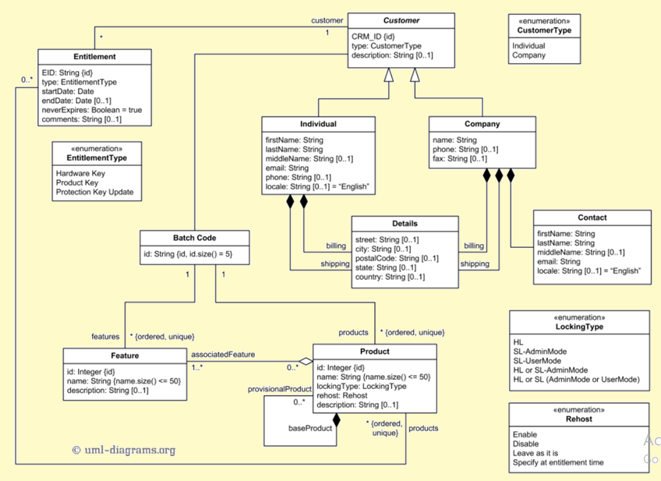

Slide 51
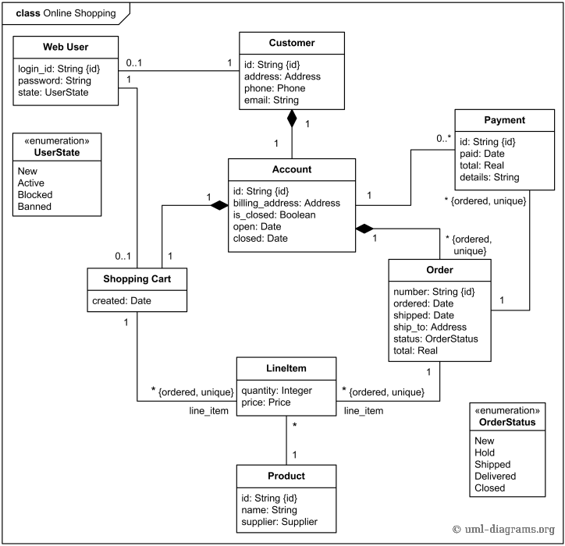

Slide 52
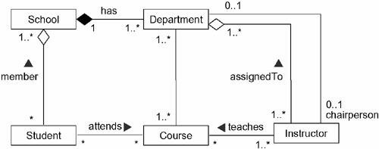

Slide 53
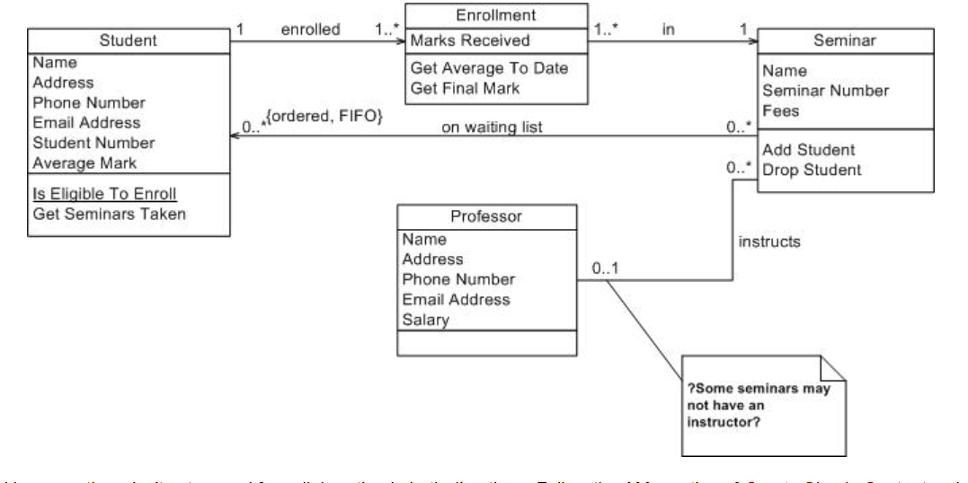

Slide 54
